Slide 1

Computer Network
(Seminar)
(Unit of Dr. R.N. Gupta Technical Educational Society)
AFFLIATED TO BOARD OF TECHNICAL EDUCATION
PITAMPURA, DELHI - 110088
Presented to:- Presented By:- Mr. Shaharyar Taj KULDEEP TIWARI
Guide & Lecturer ITES&M : 5th Sem
Aditya Institute of Technology Roll no : 1836111010

Slide 2
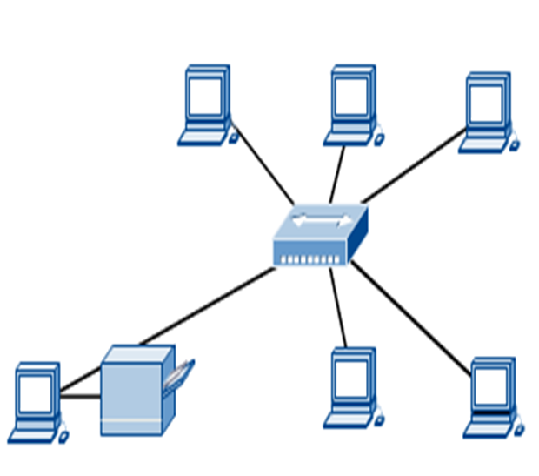
Introduction to computer network
Computer network connects two or more autonomous computers or peripheral devices.
They may be personal computers or large frame computer .
The computer may be connected via any data communication link like copper wires or radio wave etc.

Slide 3
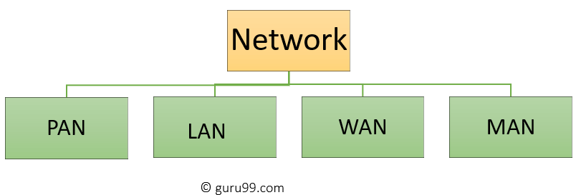
Types Of Computer Network
LAN(Local Area Network)
PAN(Personal Area Network)
MAN(Metropolitan Area Network)
WAN(Wide Area Network)

Slide 4
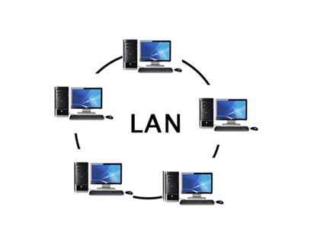
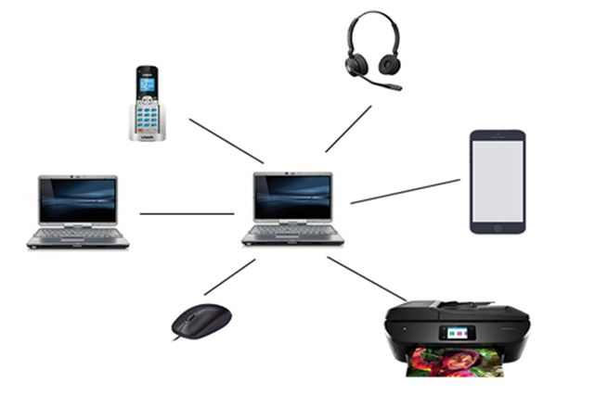
A Local Area Network (LAN) is a group of computer and peripheral devices which are connected in a limited area such as school, laboratory, home, and office building..
PAN is a computer network formed around a person. It generally consists of a computer, mobile, or personal digital assistant.

Slide 5
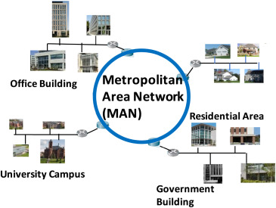
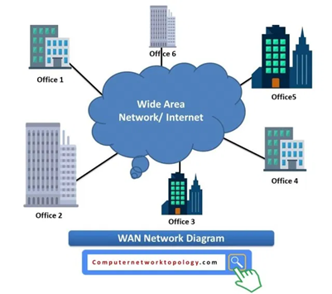
A metropolitan area network is a network that covers a larger geographic area by interconnecting a different LAN to form a larger network. Government agencies use MAN to connect to the citizens and private industries.
AN (Wide Area Network) is another important computer network that which is spread across a large geographical area.

Slide 6
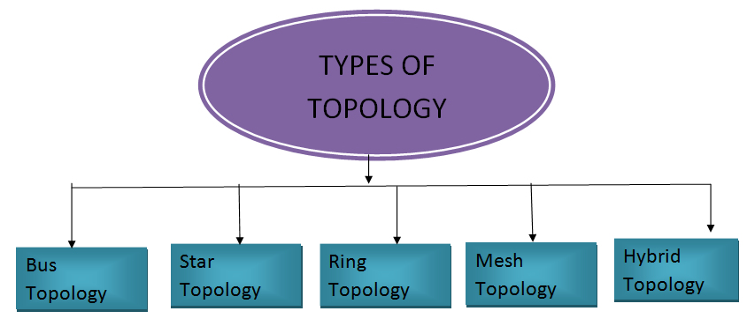
Network Topology
Network topology is the arrangement of the various elements (links, nodes, etc.) of a computer network. Essentially, it is the topological structure of a network and may be depicted physically or logically.

Slide 7
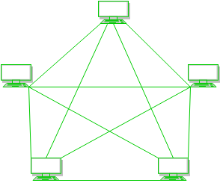
a) Mesh Topology :
In mesh topology, every device is connected to another device via particular channel.
Advantages of this topology :
Fault is diagnosed easily. Data is reliable because data is transferred among the devices through dedicated channels or links.
Provides security and privacy.
Problems with this topology :
Installation and configuration is difficult.
Cost of maintenance is high.

Slide 8
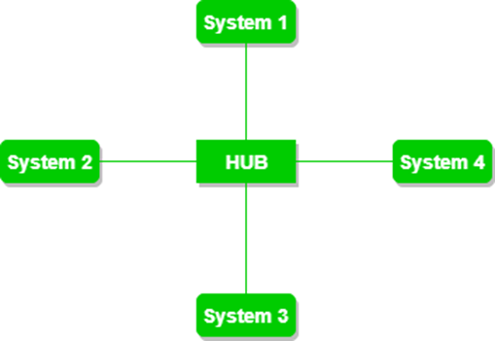
2) Star Topology : In star topology, all the devices are connected to a single hub through a cable. This hub is the central node and all others nodes are connected to the central node
Advantages of this topology :
If N devices are connected to each other in star topology, then the number of cables required to connect them is N. So, it is easy to set up.
Each device require only 1 port i.e. to connect to the hub.
Problems with this topology :
If the concentrator (hub) on which the whole topology relies fails, the whole system will crash down.
Cost of installation is high.
Performance is based on the single concentrator i.e. hub.

Slide 9
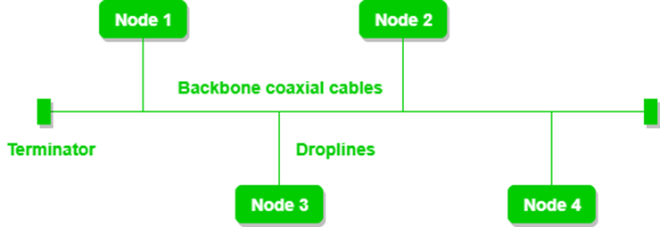
3) Bus Topology :
Bus topology is a network type in which every computer and network device is connected to single cable. It transmits the data from one end to another in single direction.
Advantages of this topology :
If N devices are connected to each other in bus topology, then the number of cables required to connect them is 1 which is known as backbone cable and N drop lines are required.
Cost of the cable is less as compared to other topology.
Problems with this topology :
If the common cable fails, then the whole system will crash down.
If the network traffic is heavy, it increases collisions in the network

Slide 10
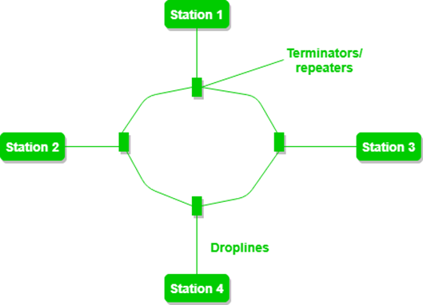
4) Ring Topology :
In this topology, it forms a ring connecting devices with its exactly two neighboring devices
Advantages of this topology :
The possibility of collision is minimum in this type of topology.
Cheap to install and expand.
Problems with this topology :
Troubleshooting is difficult in this topology.
Addition of stations in between or removal of stations can disturb the whole topology.

Slide 11
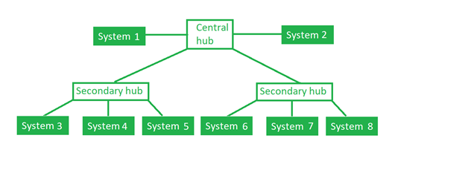
5) Tree Topology :
This topology is the variation of Star topology. This topology have hierarchical flow of data. In this the various secondary hubs are connected to the central hub which contains the repeater
Advantages of this topology : It allows more devices to be attached to a single central hub thus it increases the distance that is travel by the signal to come to the devices.
It allows the network to get isolate and also prioritize from different computers.
Problems with this topology :
If the central hub gets fails the entire system fails.
The cost is high because of cabling.

Slide 12
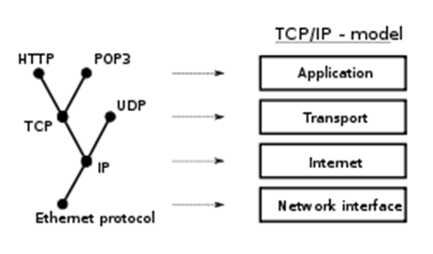
Network Protocol
A network protocol defines rules and conventions for communication between network devices. Protocols for computer networking all generally use packet switching techniques to send and receive messages in the form of packets.

Slide 13
File Transfer Protocol -The File Transfer Protocol (FTP) is a standard network protocol used to transfer computer files from one host to another host over a TCP-based network, such as the Internet.FTP is built on a client-server architecture and uses separate control and data connections between the client and the server.
Internet Protocol (IP)
Internet Protocol is connectionless and unreliable protocol. It ensures no guarantee of successfully transmission of data.
In order to make it reliable, it must be paired with reliable protocol such as TCP at the transport layer.
UDP
UDP stands for User Datagram Protocol.
UDP is a simple protocol and it provides nonsequenced transport functionality.
UDP is a connectionless protocol.
This type of protocol is used when reliability and security are less important than speed and size .
TCP
TCP stands for Transmission Control Protocol.
It provides full transport layer services to applications.
It is a connection-oriented protocol means the connection established between both the ends of the transmission. For creating the connection, TCP generates a virtual circuit between sender and receiver for the duration of a transmission.

Slide 14
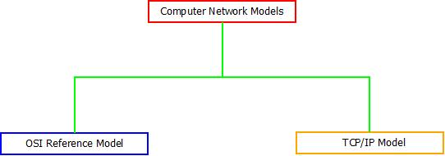
Computer Network Models
A communication subsystem is a complex piece of Hardware and software. Early attempts for implementing the software for such subsystems were based on a single, complex, unstructured program with many interacting components.

Slide 15
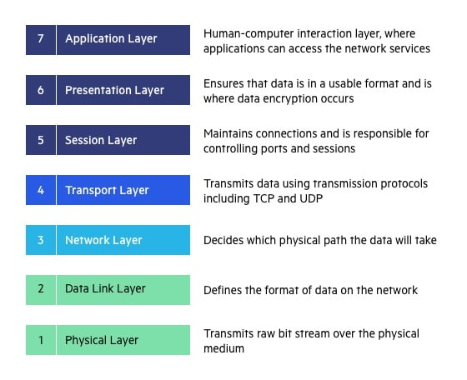
OSI Model
OSI stands for Open System Interconnection is a reference model that describes how information from a software application in one computer moves through a physical medium to the software application in another computer.

Slide 16
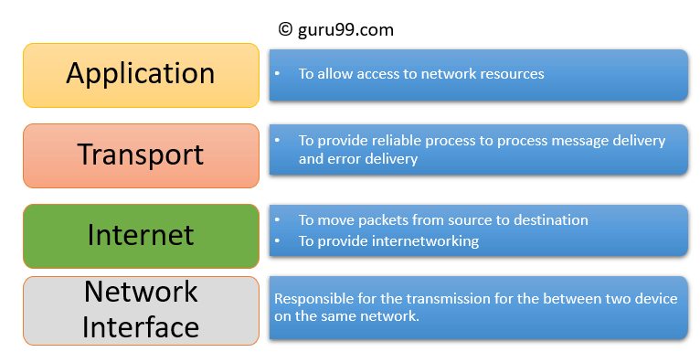
TCP/IP model
The TCP/IP model was developed prior to the OSI model.
The TCP/IP model is not exactly similar to the OSI model.
The TCP/IP model consists of five layers: the application layer, transport layer, network layer, data link layer and physical layer.

Slide 17
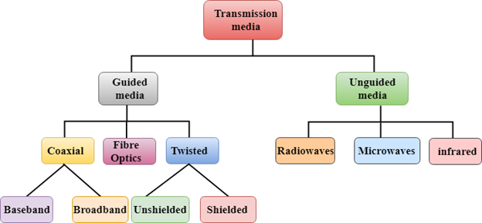
Transmission media
Transmission media is a communication channel that carries the information from the sender to the receiver. Data is transmitted through the electromagnetic signals.

Slide 18
Advantages of computer network ADVANTAGES OF COMPUTER NETWORK
Increase Speed
Reduce Cost
Improved Security
Electronic Mail
Flexible Access
Centralized Software Managment

